Slide 1
“The trouble with the future is that it usually arrives before we’re ready for it.” Arnold H. Glasow
1
Notes:
1
(This side sets the “mood” to think about change)

Slide 2
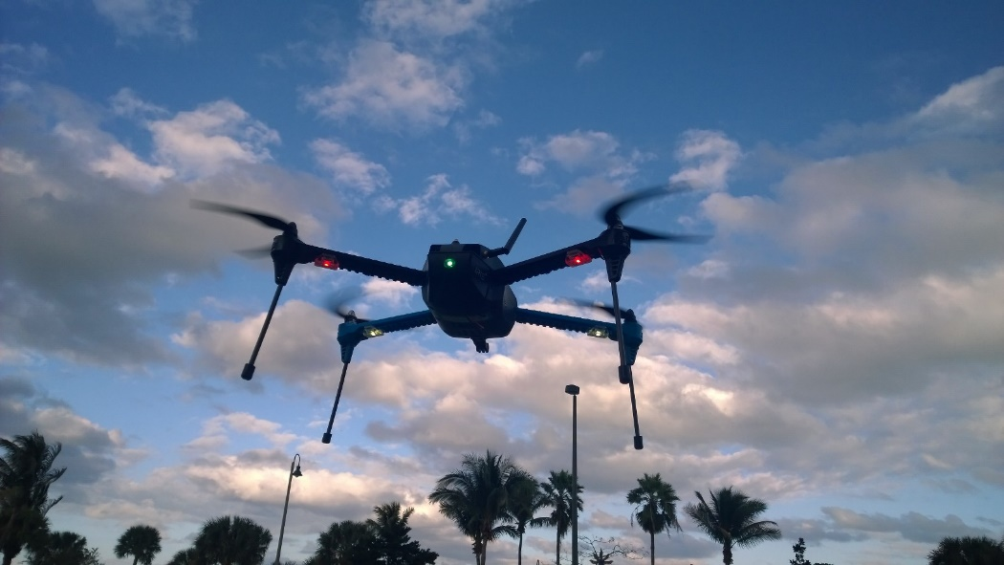

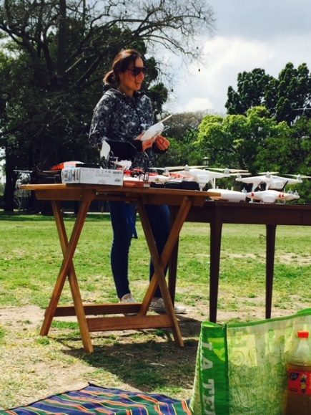
Drones in the Cloud
Guada Casuso
@guadacasuso

Slide 3
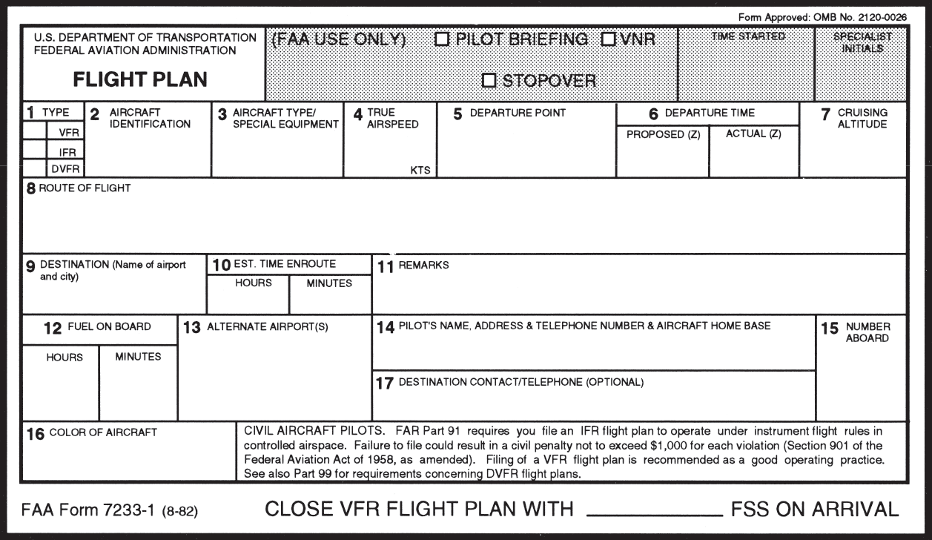
11.15
Traditions
3.45pm
Take Off: Overview
Calibrate: Programming drones
Hover: Services in the Cloud
Landing: Q&A
Colombus Ohio
FAA & Legal is Out of the Scope
1
00
Guada Casuso
@CloudDevelop ☺

Slide 4
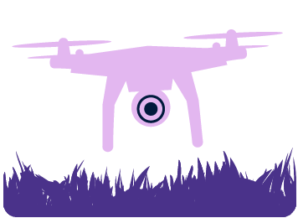
Take Off
Overview: Drones, UAVs, Copters
Notes:
Microsoft Azure IoT Suite Preconfigured Solutions.
We will focus on the Remote Monitoring solution.

Slide 5
“Jerga” for a Dummy
UA Unmanaged Aerial Vehicle
UAS Unmanaged Aerial Systems
NAS National Aeronautics Space
NDVI Normalized Differential Vegetation Index
APM autopilot platform
Ardupilot APM
IOC= Intelligent Orientation Control
FPV = First Person View
Antennas, Batteries…. []
Notes:
Additional slide for IoT Hub.

Slide 6
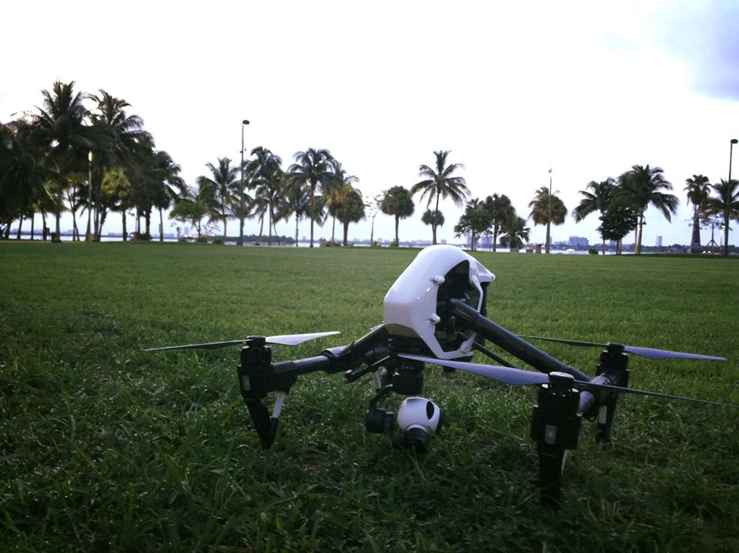
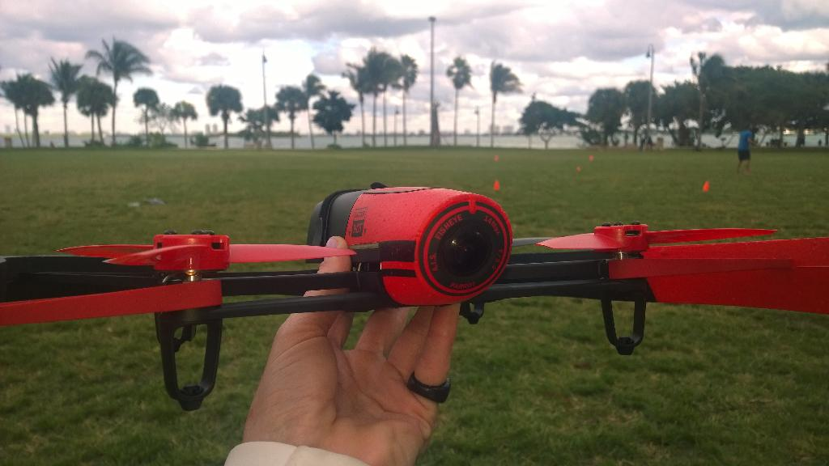
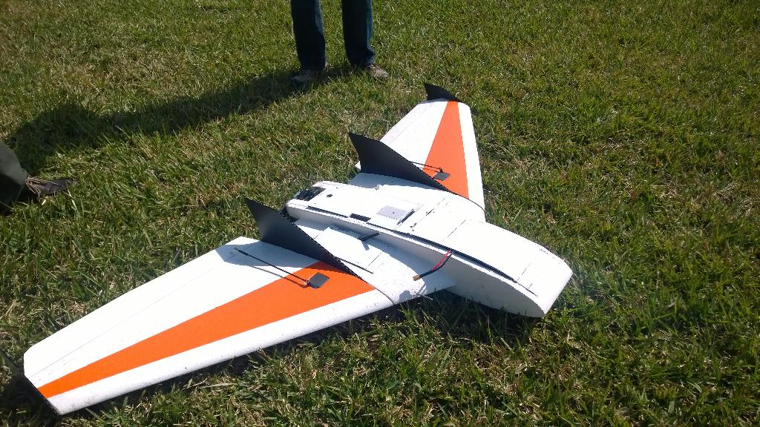
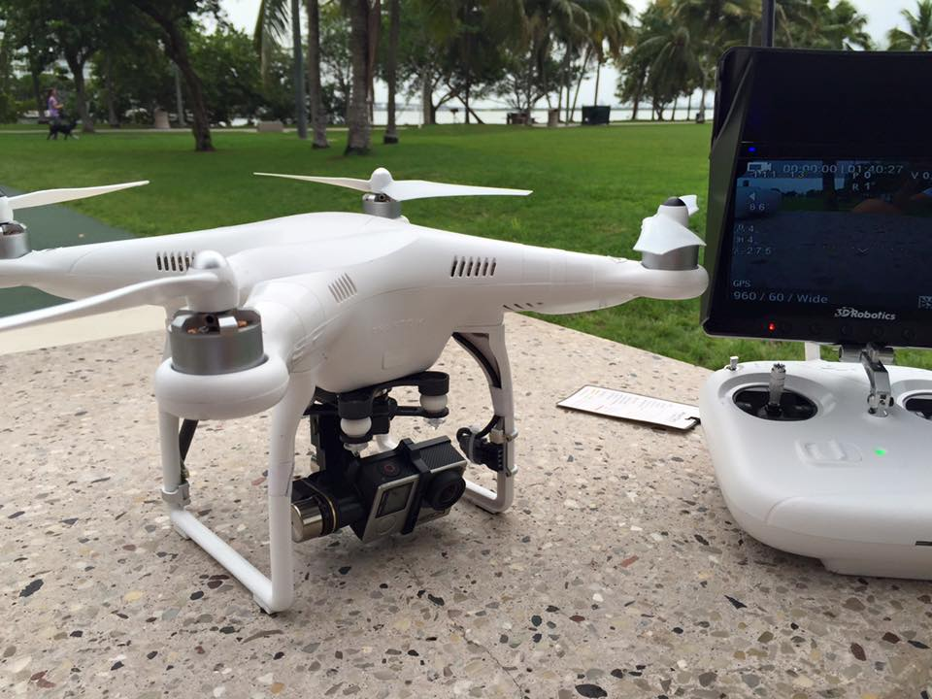
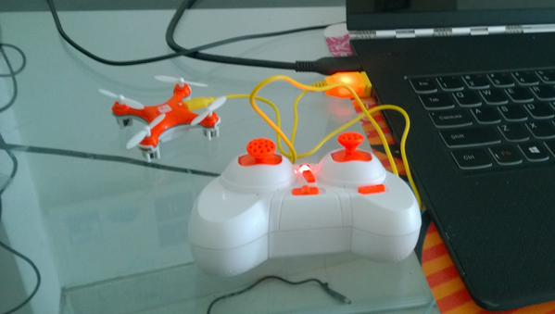
Classification
Notes:
Additional slide for IoT Hub.

Slide 7



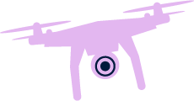

UAS components
Airframe & Structure (Motors, Propellers)
Sensors: Acelerometer, Giroscope, magnetómetro, Ultrasounds
Batteries
Camera
Communication Channel
Flight Control System (Ground Base
+ Operator)
Cloud Services
Notes:
Additional slide for IoT Hub.

Slide 8

Unlimited Applications
Military/Security
Defense
Civil
Defense
Natural Disasters
Humanitarian Relief
Science
Environment
Weather & Storm Tracking
Commercial
Wireless Communications
Precision Agriculture
Cargo Transport
Gaming
AI
VR
Events
Notes:
Additional slide for IoT Hub.

Slide 9

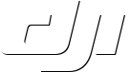

Drone’s Market - Players
Notes:
Additional slide for IoT Hub.

Slide 10
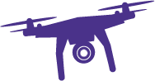

Calibrate
Programming Drones
Notes:
Microsoft Azure IoT Suite Preconfigured Solutions.
We will focus on the Remote Monitoring solution.

Slide 11




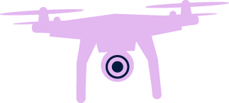



Objects & Sensors
Camera
Battery
Real-Time Video
Gimbal
Flight System
Remote
Controller
Ground Station

Slide 12
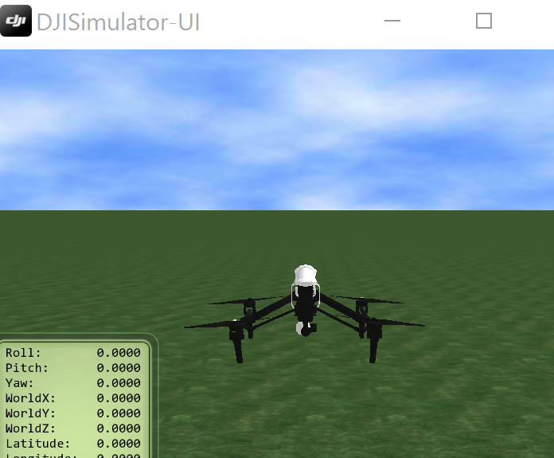
Flip!
Flying from your PC
Programing Mobile Drone Apps – SDKs & Stuff

Slide 13
Hover
IoT, Cloud and Data Services
Notes:
Microsoft Azure IoT Suite Preconfigured Solutions.
We will focus on the Remote Monitoring solution.

Slide 14
Microsoft Azure IoT Suite
Connect & Scale
Analyze & Act
Integrate & Transform
Notes:
You have now seen all of the individual parts of the Microsoft Azure IoT Suite and how they combine to create a simple but powerful preconfigured solution for IoT needs.
Summarize Azure IoT Suite
Connect and scale
Analyze and act
Integrate and transform

Slide 15
Flip!
Stream Analytics
Event Hub
Analyzing Telemetry Data from Drones
(Event Hub & Stream Analytics)

Slide 16



Microsoft Azure IoT Suite
Connect and scale
with efficiency
Analyze and act
on new data
Integrate and transform
business processes
Preconfigured solutions
Event processing
Workflow integration
Heterogeneous agents
Predictive analytics
Push and broadcast notifications
Connect and control
Data visualization
ID and access management
Notes:
The preconfigured solutions combine the shown Microsoft Azure products simply to achieve the above goals and requirements.

Slide 17
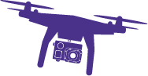

Drones Remote Monitoring
Azure IoT Suite – Drones Remote Monitoring
Web/Mobile App
Power BI
Devices
Back end systems and processes
Storage blobs
DocumentDB
IoT Hub
Stream Analytics
Event Hub
Web Jobs
Logic Apps
Azure
Active Directory
Notes:
How does it work? As mentioned; the solution is a combination of multiple back-end components. This architecture diagram shows the individual Microsoft products and services that are utilized.
Reference Architecture for Remote Monitoring solution, what products are used and why? ->
Provision simulated devices with a C# device emulator running .Net. Create agents for Linux, iOS, Android and other platforms with C and Java language support.
IoT Hub manages the two way communication between cloud and device and creates a secure command and control channel.
Azure Stream Analytics creates and manages jobs to recognize threshold values or detect alarm triggers, sending this information where it needs to be escalated.
Event Hub is queried by a web job running an event processor host to determine where and alarm or alert needs to be pushed – such as sending an alert to dashboard for a human operator to take action.
Logic Apps are used to create more complex work loads and integrate into line of business and other proprietary applications.
Document DB stores all the metadata and device properties for each connected device.
Blobs store telemetry information and telemetry data. Other tools such as Azure Machine Learning and PowerBI can access this information for data visualization or processing advanced analytics.
Webapp – Dashboard code is available in Github allowing it to be fully customized by the user to align with a scenario or be relevant for an enterprise application.
Azure Active Directory controls user ID’s and access, allowing the service to be shared with relevant decision makers within the business but restrict access to certain controls or devices.
PowerBI is used for both open-source embedded components within the dashboard and also for complex external analytics of trends and patterns across all stored data.

Slide 18
Flip!
Drones talking the Cloud
(integrating IoT Suite)

Slide 19

Landing
Questions
@guadacasuso
Notes:
Microsoft Azure IoT Suite Preconfigured Solutions.
We will focus on the Remote Monitoring solution.

Slide 20
Appendix
Notes:
Microsoft Azure IoT Suite Preconfigured Solutions.
We will focus on the Remote Monitoring solution.

Slide 21
Model | Best for | Camera | Specs | Battery & Autonomy | Price | Software
Parrot arr2 http://ardrone2.parrot.com/ | Gaming Acrobatics | OnBoard 2 cameras 720p DH | Carbon fiber tubes : Total weight 380g with outdoor hull, 420g with indoor hull USB 2.0 high speed for extensions Wi-Fi b g n 3 axis gyroscope 2000°/second precision 3 axis accelerometer +-50mg precision 3 axis magnetometer 6° precision Pressure sensor +/- 10 Pa precision Ultrasound sensors for ground altitude measurement 60 FPS vertical QVGA camera for ground speed measurement | 1 Battery 1000 mAh 11 mins autonomy | 650 usd | FreeFlight (ios + Android) Linux 2.6.32 inside: 1GHz 32 bit ARM Cortex A8 processor with 800MHz video DSP TMS320DMC64x 1GB DDR2 RAM at 200MHz SDK available for developers
Parrot Bebop http://www.parrot.com/es/productos/bebop-drone | Photos & videos Sport Indoors | OnBoard Photos 4096x3072 Pix ""fisheye"" Video 1080p HD - 30 FPS | 400 gr – ABS glass fiber 2km distance with Skycrontroler 300 mt mobile app 3 Axis stabilization Wi-Fi 802.11n 2,4 y 5 GHz hasta 36 dBm - 2 antenas bibanda MIMO Channels 11 to 13 en 2,4 GHz / de 4 a 8 en 5 GHz 3 axis gyroscope 2000°/second precision 3 axis accelerometer +-50mg precision 3 axis magnetometer 6° precision Pressure sensor +/- 10 Pa precision Ultrasound sensors for ground altitude measurement | Lithium 1200 mAh 11 min autonomy | 500 usd 900 usd w/ Skycontroller | FreeFlight (ios + Android) Dual rParrot P7 Graphical Proccessor quad core. Flash mem 8 Gb. Linux SDK available for developers

Slide 22
Drone | Best for | Camera | Speed & Weight & GPS | Battery & Autonomy | Price | Software
DJI Phantom 3 (3 flavors: Standard, Professional & Advanced) http://store.dji.com/phantom/phantom-3 | Hobbyist Photography/Videos | Standard: 2.7K HD Video 12 Mgpx The Phantom 3 Professional comes with a 4K camera, while the Phantom 3 Advanced shoots 1080p HD. VISION POSITIONING Fly indoors, low to the ground, and in GPS-free areas with Vision Positioning technology. Visual and ultrasonic sensors scan the ground beneath your Phantom 3 for patterns, enabling it to identify its position and move accurately. | 6mtrs/seg ascend 2mtrs/seg desc 1300 gr Control drone 2km distance | 23 min 4480 mAh | Standard 750 Professional 1k Advanced 1.25k | DJI GO Mobile SDK: iOS & Android and Ground SDK
DJI Inspire 1 http://www.dji.com/product/inspire-1 | Proffesional Photography & Film Maping | Up to 4K video and capture 12 megapixel photos with the Inspire 1 camera. The lens consists of 9 separate elements, including an aspherical element, for extreme clarity, while Adobe DNG RAW support gives you the power to make every shot a masterpiece. VISION POSITIONING SYSTEM Flying indoors is easier than ever with Vision Positioning technology that provides accurate position holding even when GPS is unavailable. The sensors determine your Inspire 1’s location and altitude and lower the legs automatically when landing. | 2935 g Max Ascent Speed 5 m/s Max Descent Speed 4 m/s Max Speed 22 m/s (ATTI mode, no wind) Max Flight Altitude 4500 m Dual Operation Controll Slave / Master | 18 mins TB47 4500 mAh 22 mins TB48 | 2.9k | DJI GO Mobile SDK: iOS & Android and Ground SDK

Slide 23
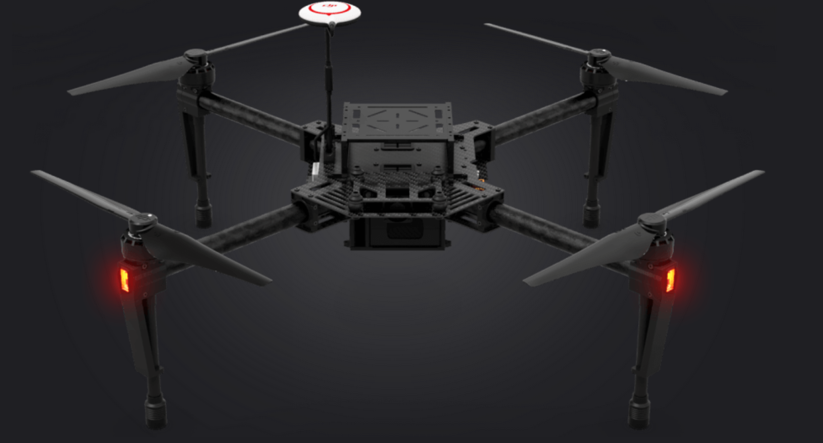
“Matrice”

Slide 24
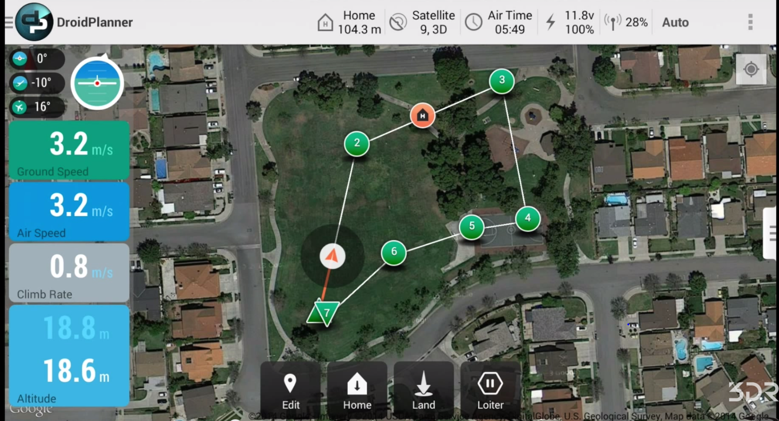
Drone | Best for | Camara | Programming | Speed & Weight & GPS | Battery & Autonomy | Price | Mobile App
Iris+ (Discontinued ) | X | GoPro | Discontinued
Solo http://3drobotics.com/solo-gopro-drone-specs/ | Video Shooting | GoPro: HERO3+® or HERO4® - The new 3-axis gimbal delivers fluid HD video to your mobile device, offers in-flight recording control and access to GoPro settings—and oh yeah, it powers your GoPro, too Streaming video quality: 720p | Yes Pixhawk 2 autopilot system, but it also runs two 1 GHz computers, one on the copter and one in the controller, connected via a powerful dedicated Wi-Fi signal carried by 3DR Link | 1.5 kg Wifi - Frequency: 2.4 GHz Max speed: 55 mph (89 km/h) Max ascent speed: 10 m/s in stabilize mode; 5 m/s in “fly” mode Max descent speed: ditto | 20-25 mins Flight battery: Lithium polymer 5200 mAh 14.8 Vdc | 1k | Solo App – Android & IOS Tower 3DR services
X8-M | Mapping | Canon S100 with custom 3DR EAI software and fixed mount | Based on the Autopilot | 3.5 kg Maximum operational wind speed: 25 mph (11 m/s) Area coverage: 25 acres* (0.1 km²) Ground sampling distance: .7 inches per pixel (2 cm per pixel)* Orthomosaic accuracy: 3-16 ft (1-5 m) | 14 min 4S 10000 mAh 10C lithium polymer | 5.4k | Pix4Dmapper Mosaic 3DR Edition (Windows only)

Slide 25
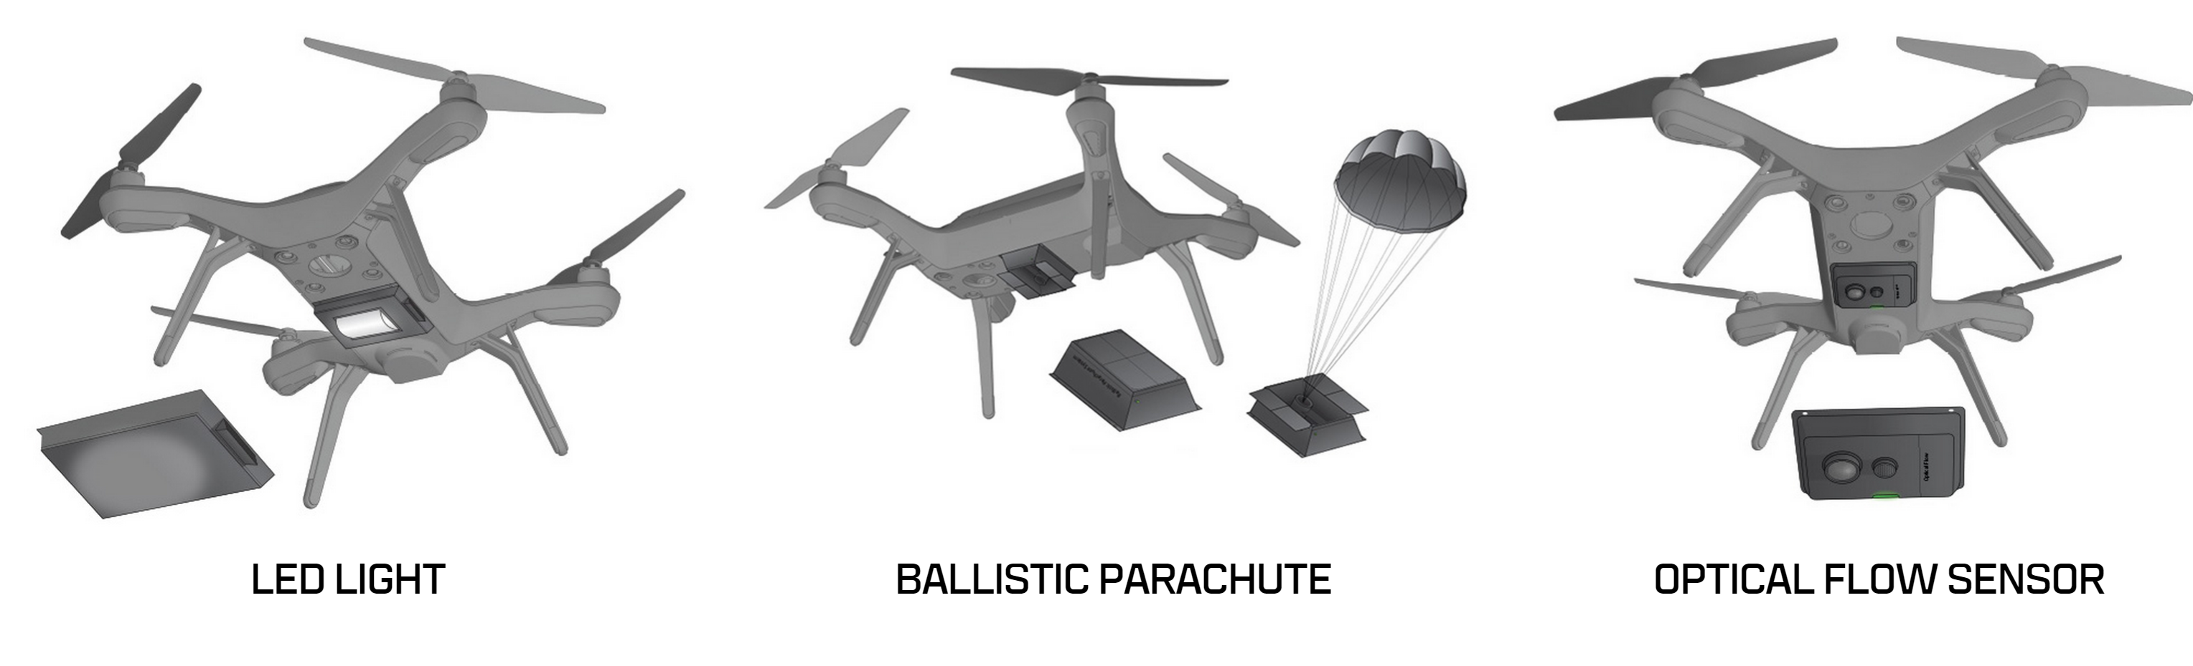
“MADE FOR SOLO”

Slide 26

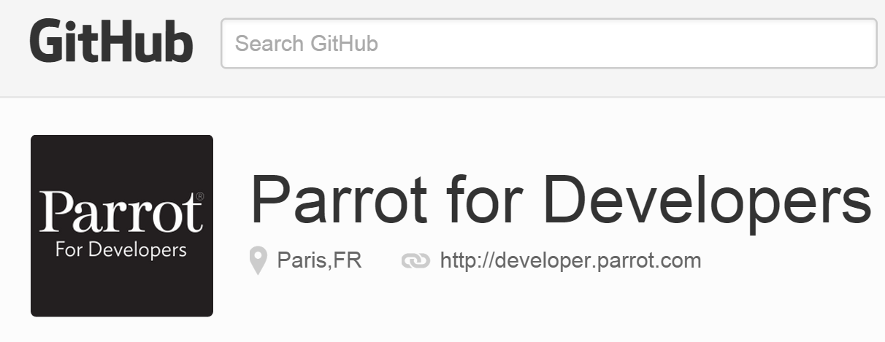
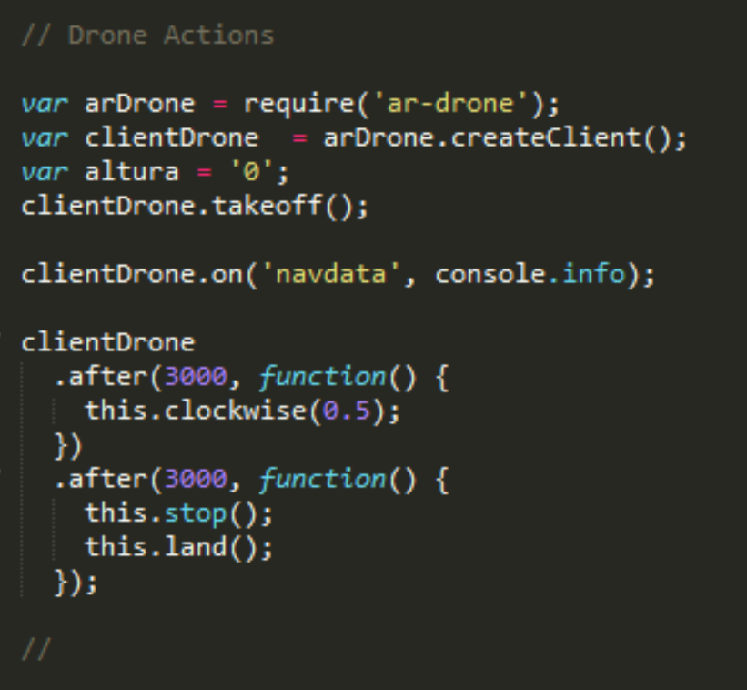
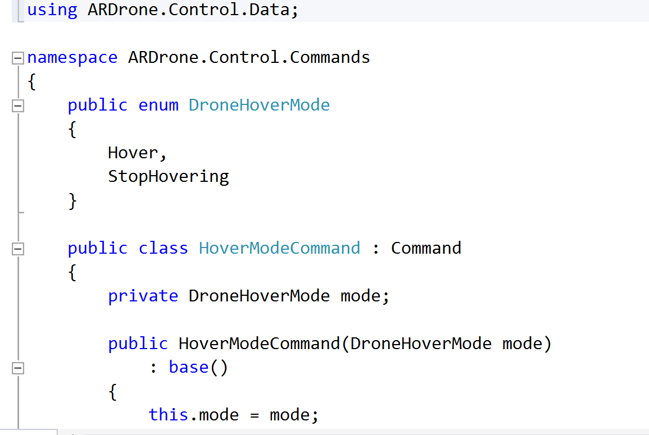
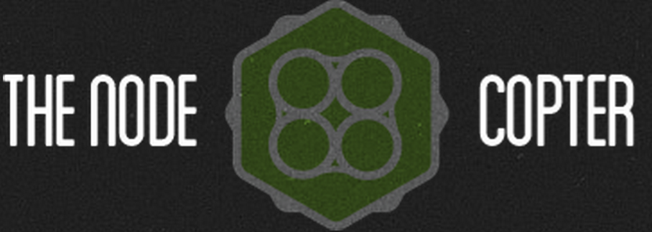

http://www.nodecopter.com/

Slide 27
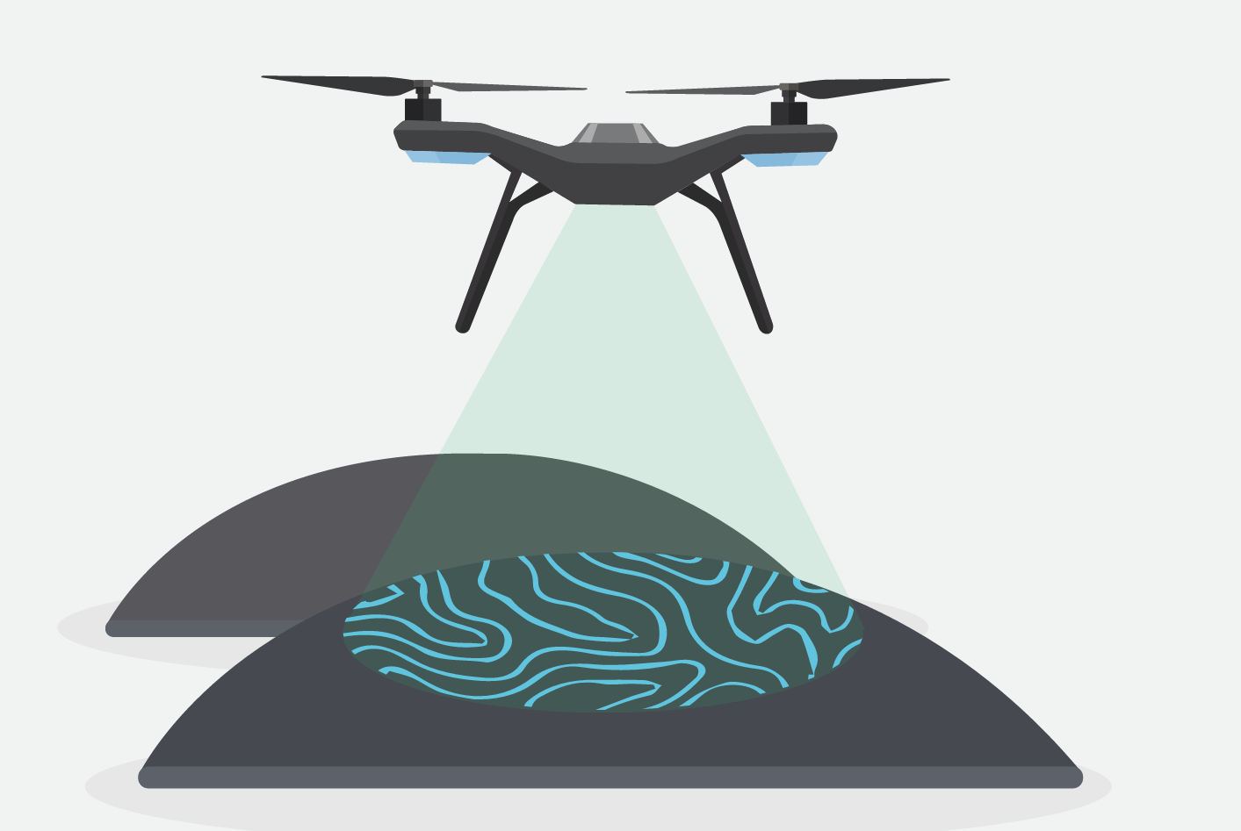



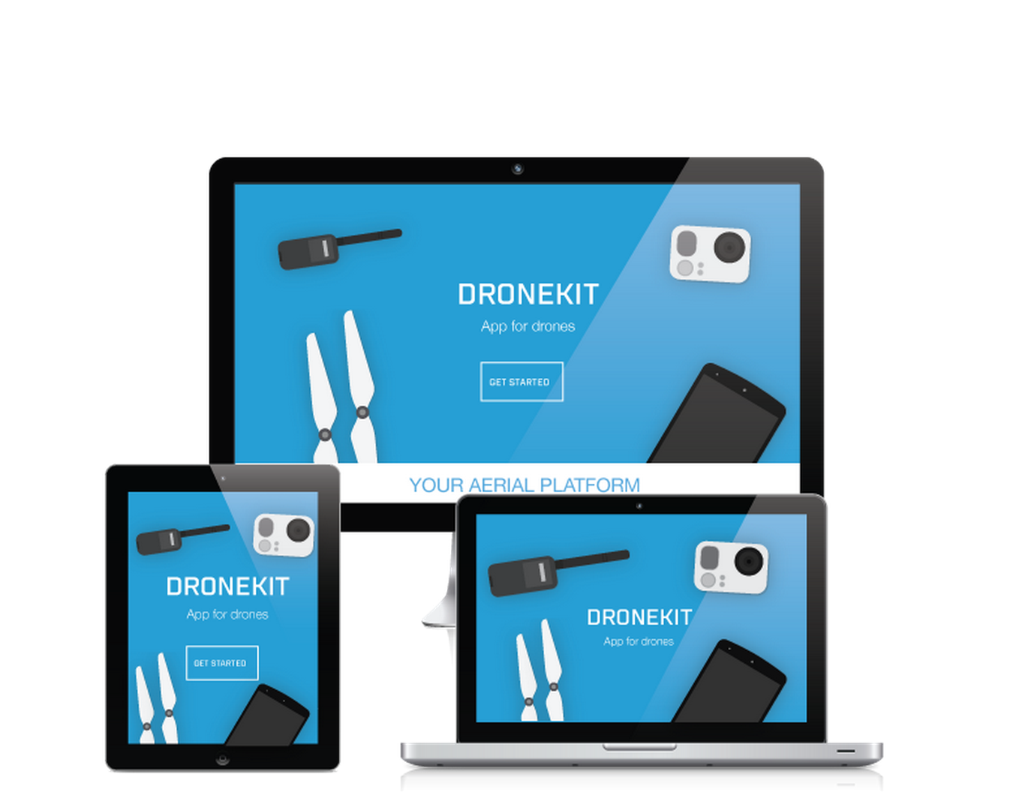
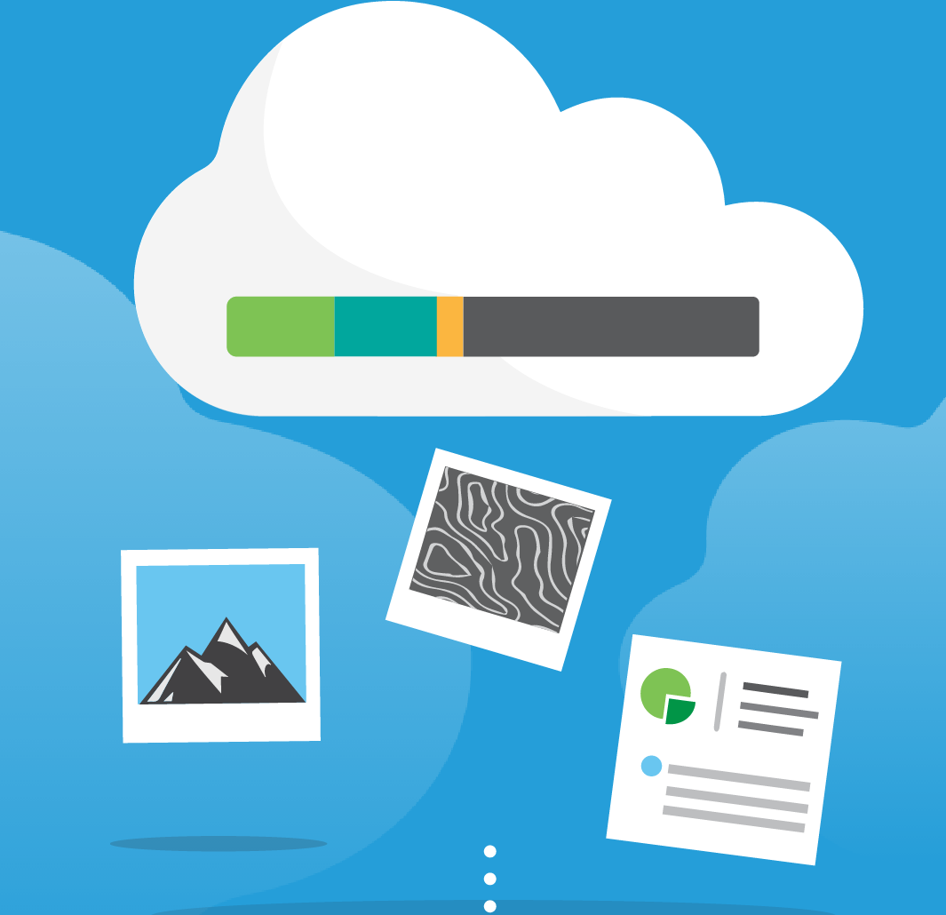

AIR: Onboard
Cloud: Rest Services
http://dronekit.io/
GROUND: Mobile

Slide 28

